Slide 1

Introduction to
Uses and Applications
Roger C. Dugan
Sr. Technical Executive, EPRI
Jacobs Hall, UCSD
Dec 14-15, 2010

Slide 2
Distribution System Simulator (DSS)
Designed to simulate utility distribution systems
  In arbitrary detail
  For most types of analyses related to distribution planning.
It performs its analysis types in the frequency domain,
    Power flow,
    Harmonics, and
    Dynamics.
  It does NOT perform electromagnetic transients (time domain) studies.

Slide 3
Time- and Location-Dependent Benefits
The OpenDSS was designed from the beginning to capture both
  Time-specific benefits and
  Location-specific benefits
Needed for
  DG analysis
  Renewable generation
  Energy efficiency analysis
  PHEV and EV impacts
  Other proposed capacity enhancements that don’t follow typical loadshapes

Slide 4
Time- and Location-Dependent Benefits
Most traditional distribution system analysis programs
  Designed to study peak loading conditions
  Capture mostly location-specific benefits
  Ignores time; Assumes resource is available
  This gets the wrong answer for many DG, energy efficiency, and Smart Grid analyses
Must do time sequence analysis to get the right answer
  Over distribution planning area

Slide 5
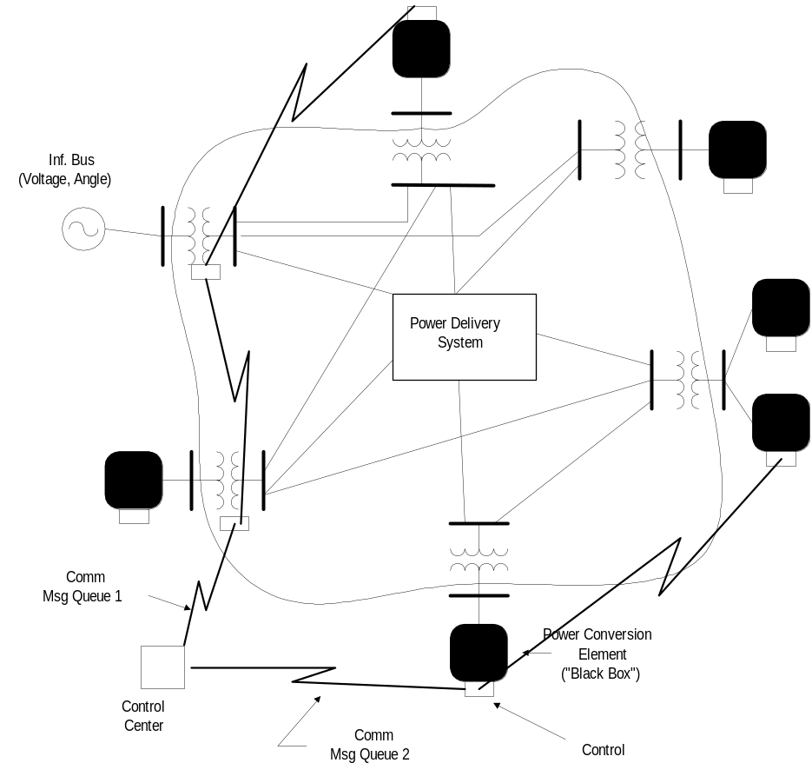
Overall Model Concept

Slide 6
Examples of Advanced OpenDSS Applications
(other than basic multi-phase power flow)
Neutral-to-earth (stray) voltage simulations.
Loss evaluations due to unbalanced loading.
Development of DG models for the IEEE Radial Test Feeders.
High-frequency harmonic and interharmonic interference.
Losses, impedance, and circulating currents in unusual transformer bank configurations.
Transformer frequency response analysis.
Distribution automation control algorithm assessment.
Impact of tankless water heaters on flicker and distribution transformers.
Wind farm collector simulation.
Wind farm impact on local transmission.
Wind generation and other DG impact on switched capacitors and voltage regulators.
Open-conductor fault conditions with a variety of single-phase and three-phase transformer connections.

Slide 7
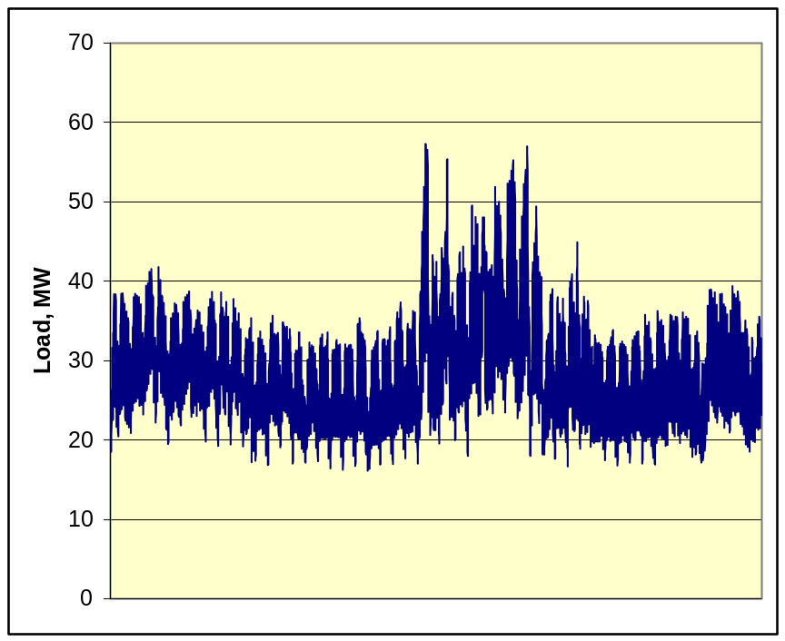
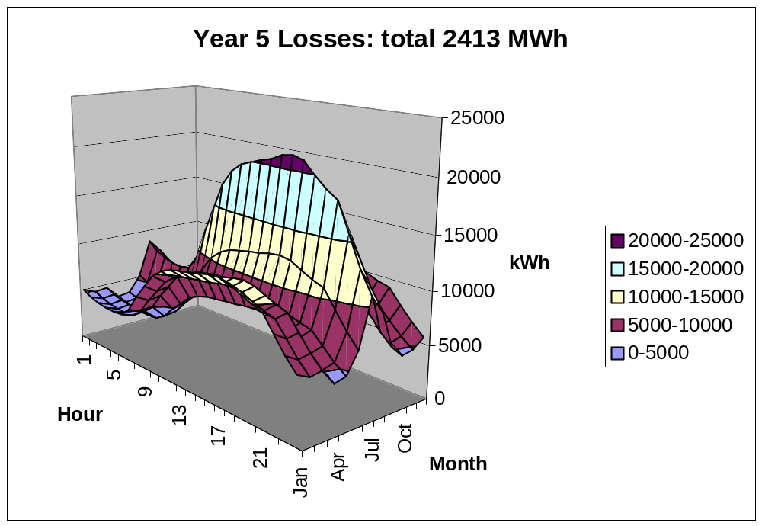
Computing Annual Losses
Peak load losses are not necessarily indicative of annual losses

Slide 8
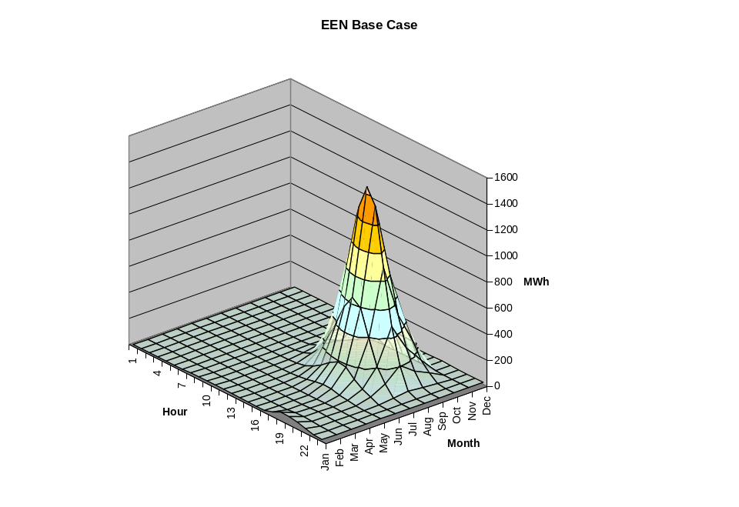
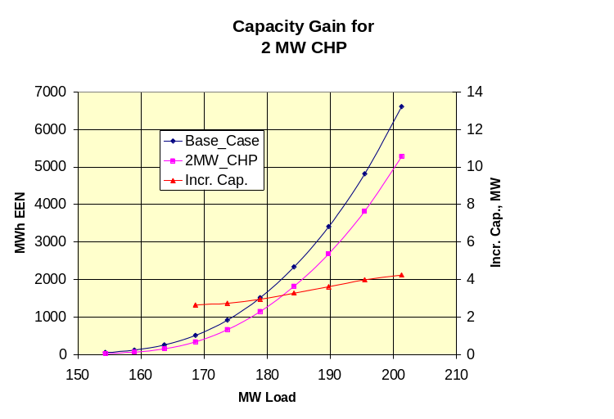
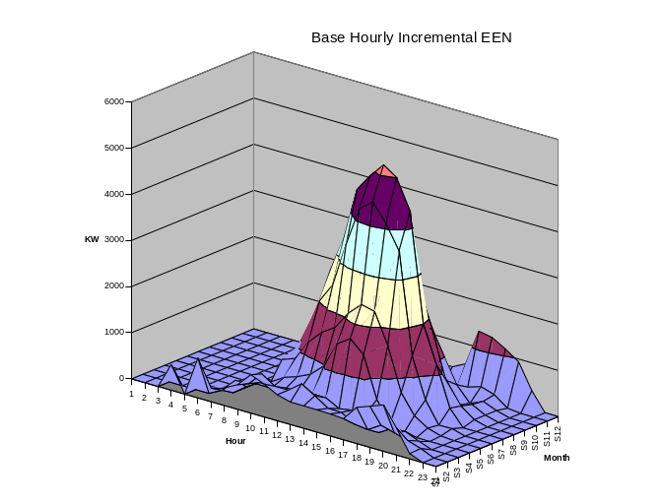
Using DSS to Determine Incremental Capacity of DG
“Needle” Peaking System
“How much more power can be served at the same risk of unserved energy?”
Broad Summer Peaking System

Slide 9
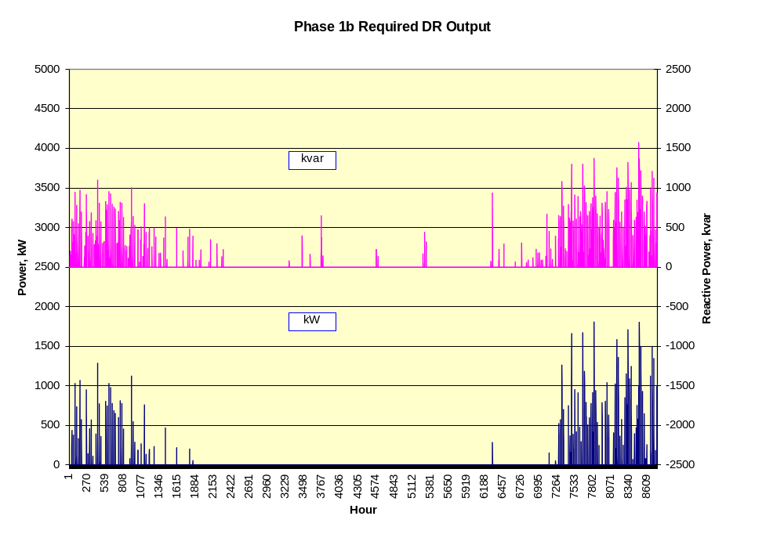
DG Dispatch

Slide 10
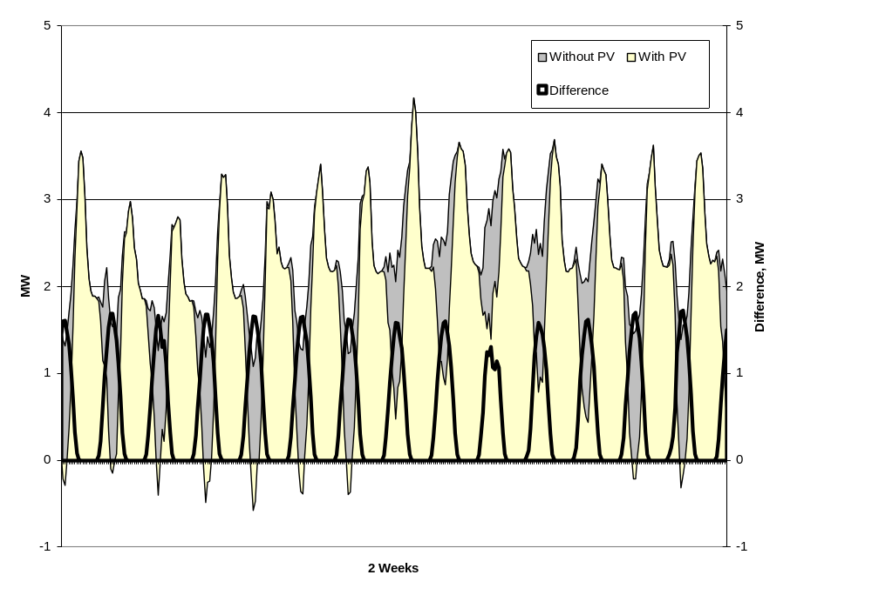
Solar PV Simulation

Slide 11
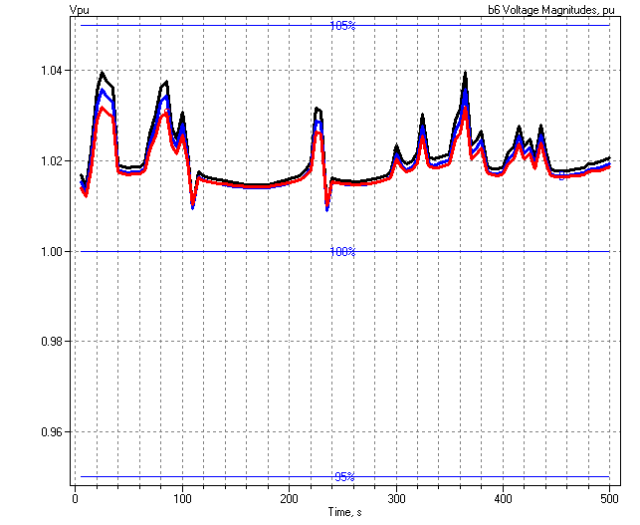
5-sec Solar Data on Day with Scattered Clouds
Impact on Feeder Voltage
of Large PV Unit

Slide 12
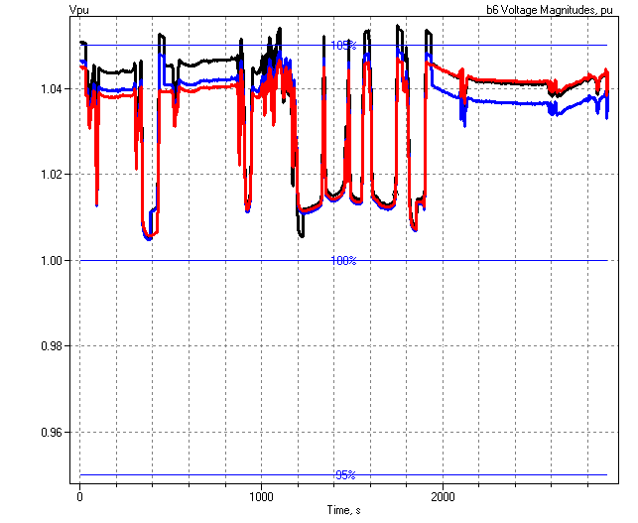
1-sec Solar Data (2010)
Regulator Operations

Slide 13
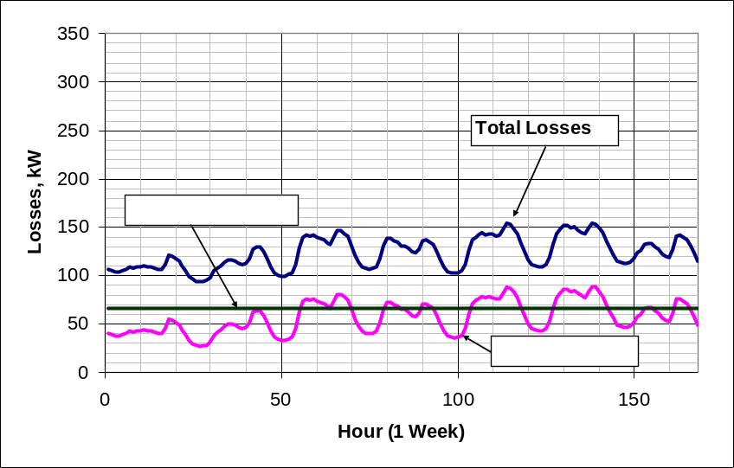
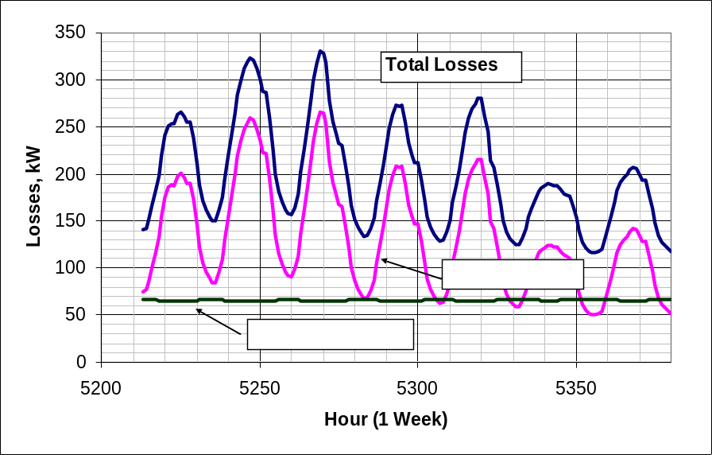
Power Distribution Efficiency
Peak Load Week
Light Load Week

Slide 14
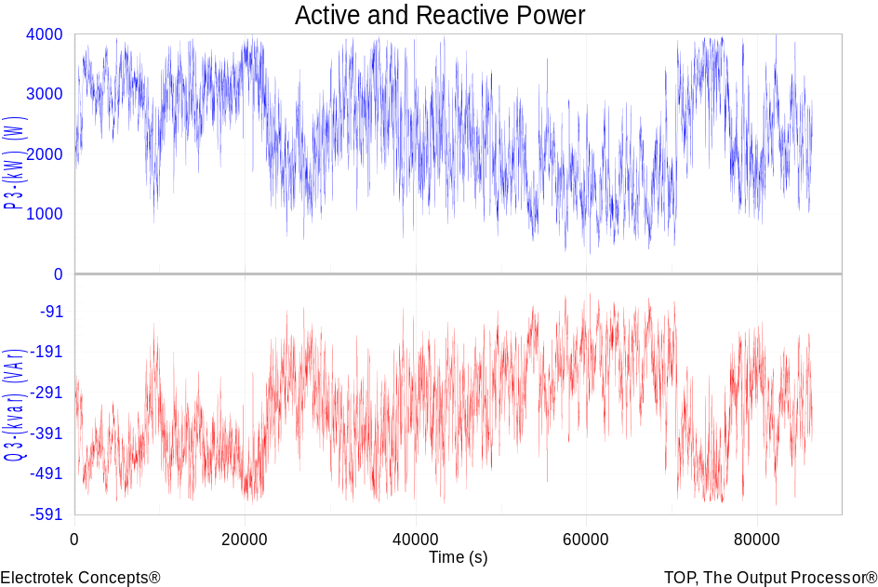
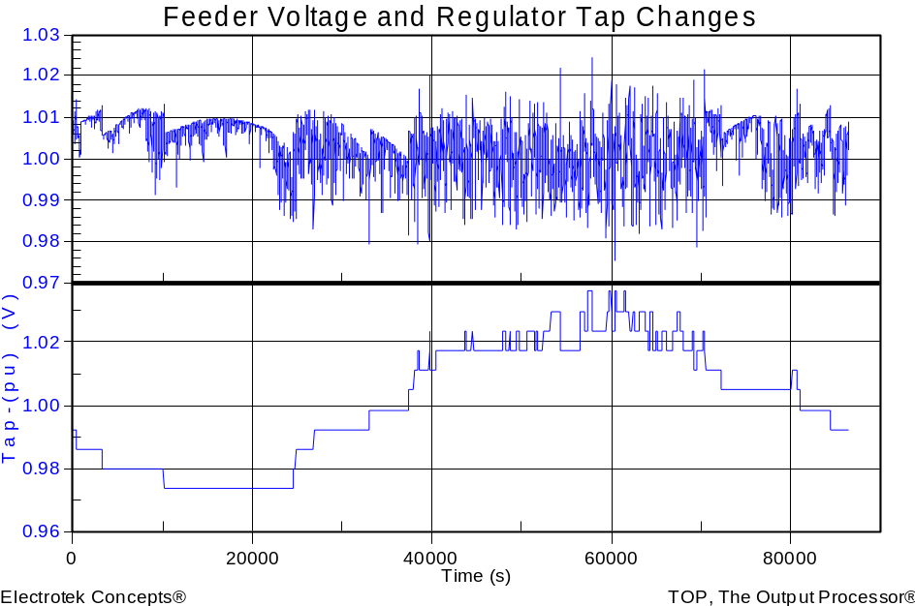
Wind Plant 1-s Simulation
Notes:
The plot you see to the right is a sample case study we did where a developer wanted to install 3 750kW turbines at the end of a 10-mile distribution feeder. Along the feeder was a voltage regulator and large intermittent load. The concern we had was the impact the turbine output fluctuations would have on the flicker, regulator action, as well as the voltage profile along the feeder. Utilizing software that Electrotek had developed, specifically the Distribution System Simulator, or DSS,, minor modifications were made that allowed us to simulate the wind plant fluctuation impact over time, thus giving us the ability to address the concerns at hand.
The plot you see to the right is simulation output from the DSS, over a time horizon of ~ 4 minutes. The three turbines were modeled explicitly, along with the 5-step switched capacitor banks connected to each turbine as well as the voltage regulator upline from the wind plant. This software allows us to make recommendations to the utility and/or wind plant developer regarding modifications necessary, if any, to allow for the wind plant to have minimal impact on the distribution feeder and surrounding customers, or perhaps even improve feeder performance.
We also utilize this software for estimating flicker according the IEC standard 1400-21. The software, along with data specific to the turbine being considered allows one to estimate the flicker impact BEFORE the turbine is installed.

Slide 15
Broadband Driving Point Admittance
0.035
0.03
0.025
0.02
Siemens
|Y|
0.015
0.01
0.005
0
0
100000
200000
300000
400000
500000
Frequency, Hz

Slide 16
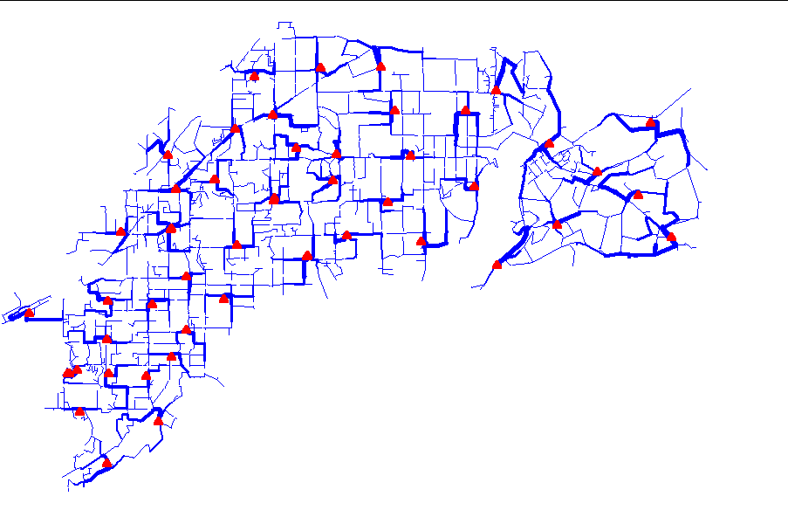
Power Flow Visualization

Slide 17
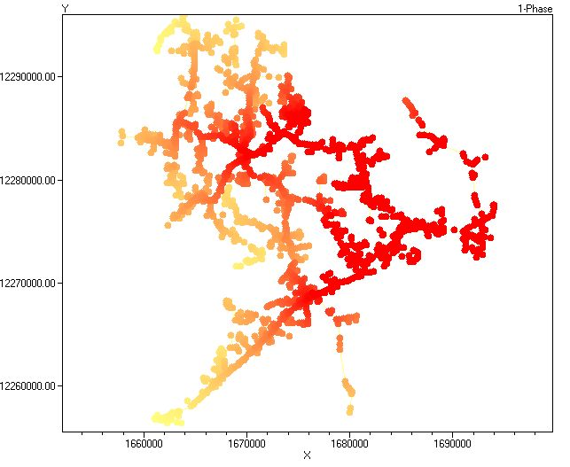
Special Displays
Fault Current Magnitudes

Slide 18
Together…Shaping the Future of Electricity

